Slide 1

Geography Mentor Meeting/ Update
Agenda
Placement 2 guidance
Ofsted for ITE - what this means for us as mentors
Core Content Framework (CCF)
AOB
10.3.21
Georgia Ramsay

Slide 2
Our Current Context
The geography PGCE is a new course at the UoY (Sept 2020)
Most of our trainees had their placement 1 extended until 12th March
Some trainees are staying in their placement 1 school for the duration of their teaching practice
Some trainees started their second placement after February half term
All trainees have had less face to face experience in the classroom, due to the national lockdown.

Slide 3
Support for Mentors
UoY PGCE mentor website
Mentor handbook
Geography mentor resources/ pack
Geography subject specific target examples
PebblePad explained - video 9 mins
New mentor training video
Weekly update (detailed update every three weeks)
Quick response to emails regarding any concerns regarding a trainee

Slide 4
Important Dates
Please complete review 2 (placement 1 schools only) for your current trainee by Friday 12th March.
Mon 15th March, Wed 17th March & Fri 19th March, trainees have university provision
Tues 16th & Thurs 18th March, induction days in new placement schools if this is possible. Please liaise with your Professional Tutor, who should let trainees know what the arrangements for their induction are.
Mon 22nd March, placement 2 commences

Slide 5
Important Dates
University visits will begin the second week back after Easter (w/b 19th April for York/ NY/ Wakefield Schools, w/b 26th April for Leeds schools).
External examiner visits w/b 3rd May and w/b 10th May
Review 3 (final review) deadline Wed 19th May
Final day in placement school is Friday 21st May

Slide 6
Placement 2 Guidance
1
Timetable
2
Mentor Meetings
3
Lesson Observations
40-50% teaching straight away (10-12 hours)
After Easter increase to 50-60% solo teaching (12-15 hours)
By May, 60% solo teaching (15 hours) and up to 15% (3 hours) additional tasks/ support
Weekly meeting (one hour in total)
2-3 targets per week, with links to the TS
Trainee completes the weekly mentor meeting template (verified by mentor) and uploads onto PebblePad
One formal lesson obs per week on UoY template (on website and PebblePad)
Informal lesson feedback to be recorded in the trainees reflections book (exercise book) using WWW/ EBI
Host teacher remains in the class (or nearby once trainee is established)

Slide 7
Example Placement 2 Timetable
 | Mon | Tues | Wed | Thurs | Fri
Reg | 8Gr | 8Gr | 8Gr | 8Gr | 8Gr
P1 |  | 7Cf | 9X1 | 8Md | 10 Y3
P2 | 7Cf |  | 7Hv | Yr 12 TT | 8Kl
P3 | 8Kl | 9X1 |  | 7Hv | 9Z1
P4 | 9Z1 |  | 10 Y3 |  | Mentor meet
Reg | 8Gr | 8Gr | 8Gr | 8Gr | 8Gr
P5 | 8Md | Yr 12 TT |  | 10Y3 | Yr 10 intervent.
First lesson with each class is an observation
Take over Yr 7,8 (and ideally 9) before Easter)
Take over Yr 10 after Easter
Occasional solo teaching/ team teaching of Yr 12 before the end of placement
Many schools ask trainees to teach a lesson of PSHCE

Slide 8
Placement 2 Guidance
4
Learning Plans and Post Lesson Reflection
5
PebblePad
Trainees must use the University of York templates provided until you are secure with the planning process
Learning plans and resources submitted for every lesson to host teacher, 48 hours in advance of the lesson
A post lesson reflection/ evaluation needs to be completed by the trainee for every lesson taught
Trainees should keep all lesson plans, resources and post lesson reflections in teacher file (physical or digital)
Each week the trainee must upload the following into their PebblePad portfolio:
1 formal lesson observation form
1 full learning plan and resources for the observed lesson
1 full lesson evaluation for the observed lesson
1 mentor meeting record
Trainees should also record any WSI or CA training that they have in school.

Slide 9
What do all our trainees really need exposure to?
Face to face teaching, with a particular focus on behaviour management
Day to day contact with colleagues and the chance to form professional relationships in person
Opportunities to contribute to the wider life and ethos of the school

Slide 10
Just so you are aware...
On 15th March, I will be launching Assignment 3 with the trainees (deadline 28th May)
(a) conduct your own small-scale classroom-based research and review relevant literature (ethics form required)
(b) conduct an extensive review of relevant evidence from school alongside relevant literature and research
Please can I ask mentors to have a conversation with their trainees regarding their ideas fo assignment 3, before Easter.

Slide 11

Any questions regarding placement 2?

Slide 12
Ofsted for ITE/ ITT - what this means for us as mentors
We are overdue an inspection (last inspected in 2013, normally a 5-6 year cycle), Ofsted also keen to visit providers where there is a new PGCE
New inspection framework from Sept 2020 - no visit prior to Easter 2021
When we are inspected by Ofsted, they will want to talk to mentors as part of the UoY partnership.
The ITE Ofsted approach is similar to that of schools and they will be looking at what happens across both the university and school based provision closely to see if our intent is implemented and then has impact.

Slide 13
Ofsted for ITE/ ITT - what this means for us as mentors
By meeting with mentors, Ofsted will want to assess how well we all work together to produce the next generation of competent and confident early career geography teachers.
If it is useful, I have produced a 2-sided summary document, designed to give clarity and consistency of messages across the partnership of schools
This 2 sided summary covers:
our curriculum ambition
how the Core Content Framework (CCF) is addressed through our taught programme (which you then compliment with the school based experience, your weekly meetings and the sessions delivered in school)
how we have addressed previous Ofsted targets
some of the questions we are expecting.

Slide 14
Ofsted for ITE/ ITT - questions we are expecting
How are you supported by the university?
What has the alternative provision been like during COVID?
How are you implementing the Core Content Framework (CCF)?
(more to follow in the next section of the meeting)
We think there will be a question about the ‘purposeful integration’ of the university and school experience , i.e. ‘the connectedness of the curriculum from subject and centre based training into placement experiences’ (wording taken from a phone call with an inspector)

Slide 15
Core Content Framework (CCF)
The CCF represents ‘the minimum entitlement’ of the teacher training year.
Here is a link to the full CCF from the DfE (pages 8-30 most relevant for mentors)
I am confident that the very vast majority of this entitlement is met through a blend of experience from both university and in school, but it would be useful if mentors could familiarise themselves with this entitlement.
What I would like us to explore further is any ideas for ensuring that the full entitlement is met in a way that is coherent and manageable across our partnership schools.

Slide 16
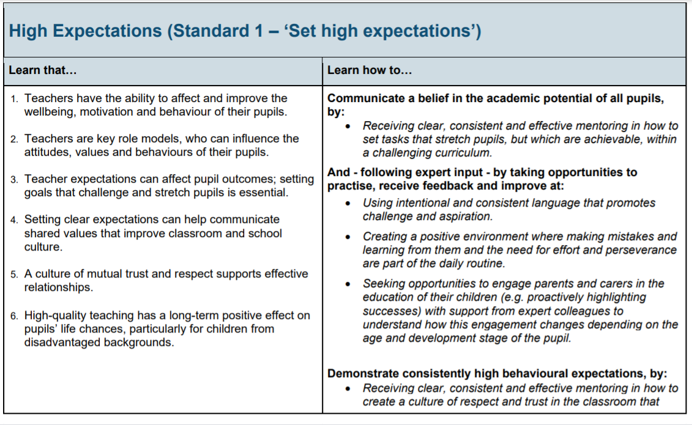

Slide 17
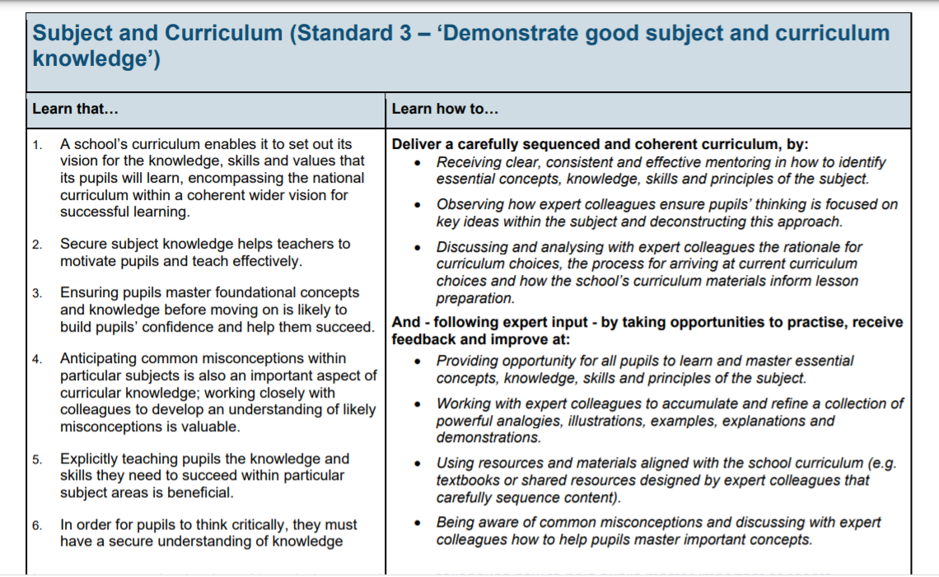

Slide 18
Any Other Business?

Slide 19


